Slide 1
Uniprocessor Scheduling

Slide 2
Aim of Scheduling
Assign processes to be executed by the processor(s)
Response time
Throughput
Processor efficiency

Slide 3
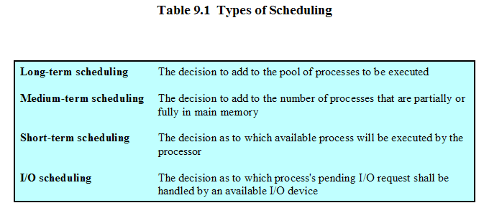

Slide 4
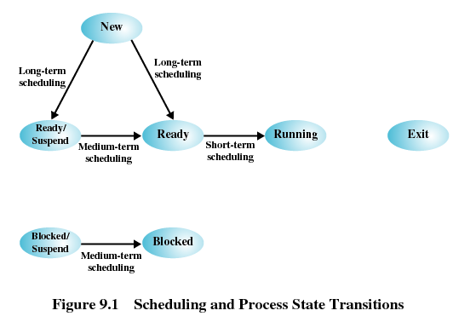

Slide 5
..\stallings\tablas\OS5e-PDF-Tables\T09-Horizontal.pdf
..\stallings\tablas\OS5e-PDF-Tables\T09-Vertical.pdf

Slide 6
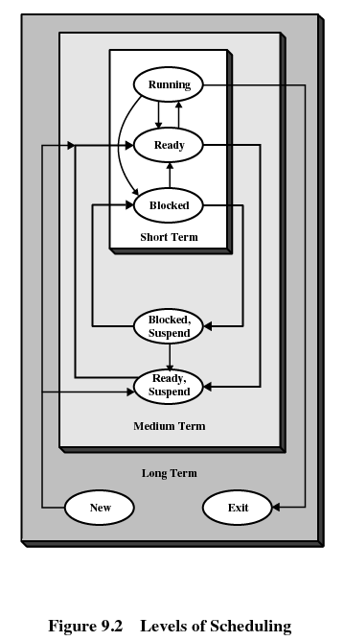

Slide 7
Long-Term Scheduling
Determines which programs are admitted to the system for processing
Controls the degree of multiprogramming
More processes, smaller percentage of time each process is executed

Slide 8
Medium-Term Scheduling
Part of the swapping function
Based on the need to manage the degree of multiprogramming

Slide 9
Short-Term Scheduling
Known as the dispatcher
Executes most frequently
Invoked when an event occurs
  Clock interrupts
  I/O interrupts
  Operating system calls
  Signals

Slide 10
Short-Tem Scheduling Criteria
User-oriented
  Response Time
    Elapsed time between the submission of a request until there is output.
System-oriented
  Effective and efficient utilization of the processor

Slide 11
Short-Term Scheduling Criteria
Performance-related
  Quantitative
  Measurable such as response time and throughput

Slide 12
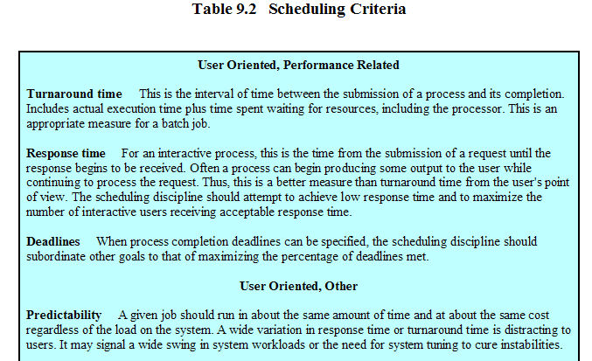

Slide 13
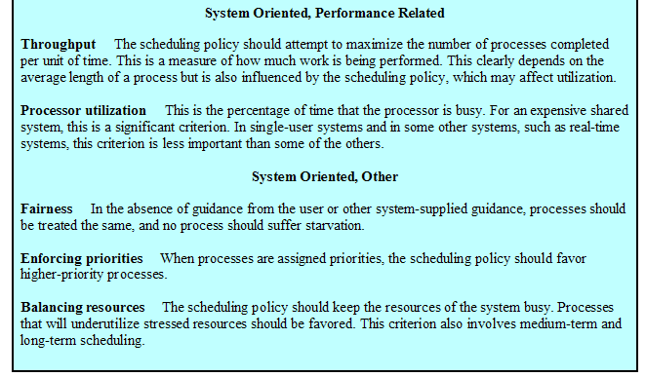

Slide 14
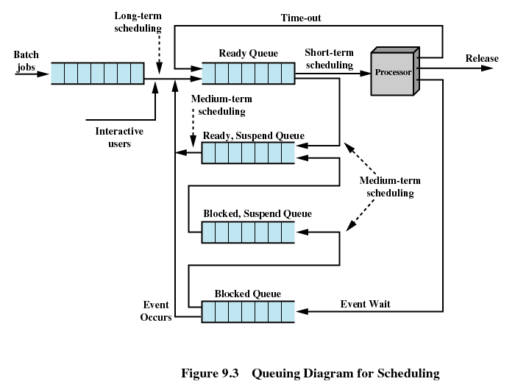

Slide 15
Priorities
Scheduler will always choose a process of higher priority over one of lower priority
Have multiple ready queues to represent each level of priority
Lower-priority may suffer starvation
  Allow a process to change its priority based on its age or execution history

Slide 16
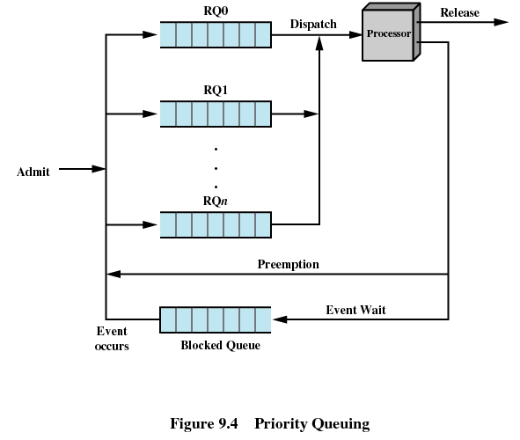

Slide 17
Decision Mode
Nonpreemptive
  Once a process is in the running state, it will continue until it terminates or blocks itself for I/O
Preemptive
  Currently running process may be interrupted and moved to the Ready state by the operating system
  Allows for better service since any one process cannot monopolize the processor for very long

Slide 18
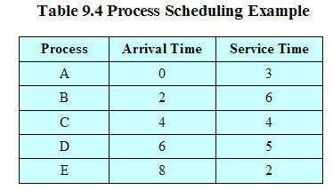
Process Scheduling Example

Slide 19
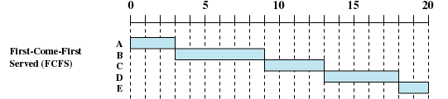
First-Come-First-Served
(FCFS)
Each process joins the Ready queue
When the current process ceases to execute, the oldest process in the Ready queue is selected

Slide 20
First-Come-First-Served
(FCFS)
A short process may have to wait a very long time before it can execute
Favors CPU-bound processes
  I/O processes have to wait until CPU-bound process completes

Slide 21


Round-Robin
Uses preemption based on a clock
An amount of time is determined that allows each process to use the processor for that length of time

Slide 22
Round-Robin
Clock interrupt is generated at periodic intervals
When an interrupt occurs, the currently running process is placed in the read queue
  Next ready job is selected
Known as time slicing

Slide 23
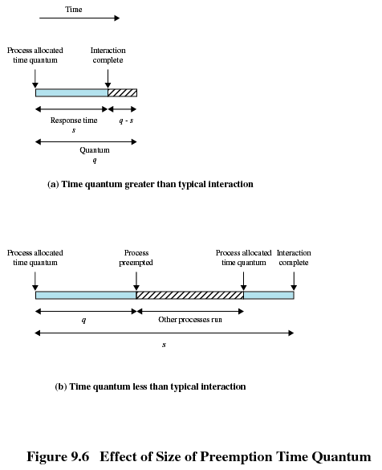

Slide 24
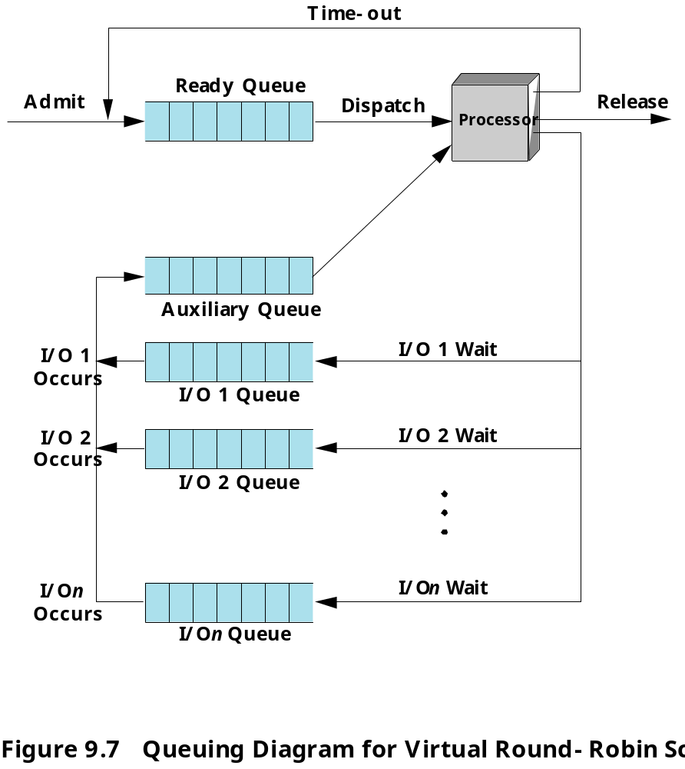

Slide 25

Shortest Process Next
Nonpreemptive policy
Process with shortest expected processing time is selected next
Short process jumps ahead of longer processes

Slide 26
Shortest Process Next
Predictability of longer processes is reduced
If estimated time for process not correct, the operating system may abort it
Possibility of starvation for longer processes

Slide 27
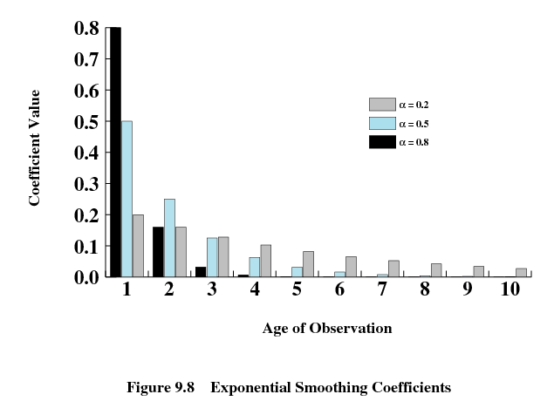

Slide 28
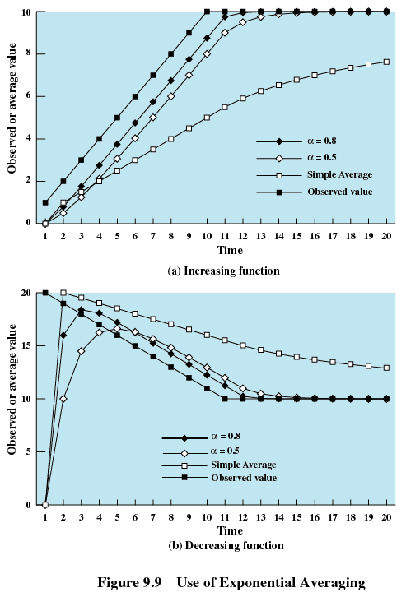

Slide 29

Shortest Remaining Time
Preemptive version of shortest process next policy
Must estimate processing time

Slide 30

Highest Response Ratio Next (HRRN)
Choose next process with the greatest ratio
time spent waiting + expected service time
expected service time

Slide 31
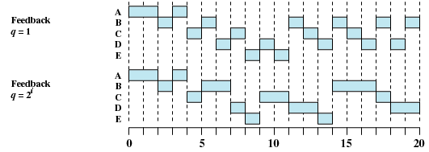
Feedback
Penalize jobs that have been running longer
Don’t know remaining time process needs to execute

Slide 32
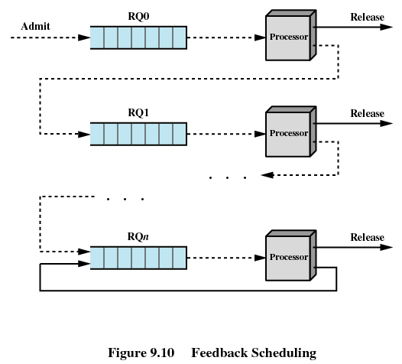

Slide 33
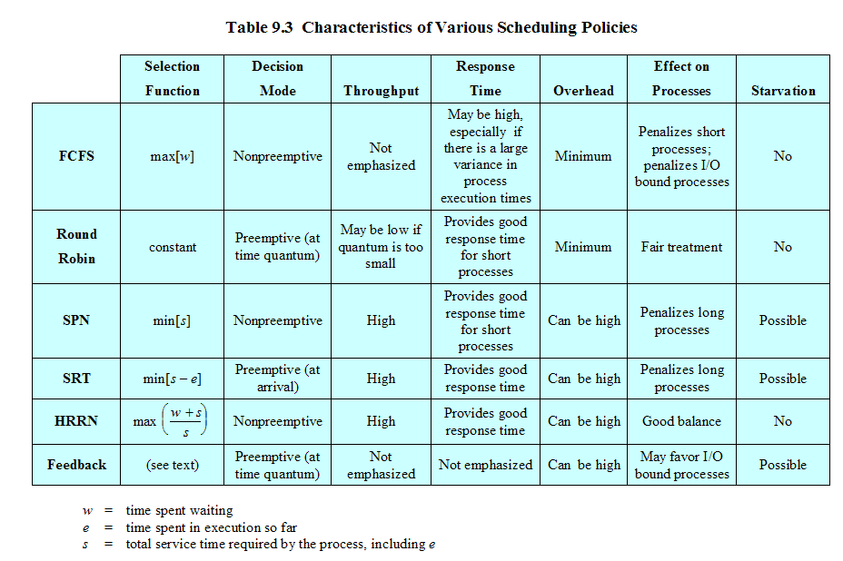

Slide 34
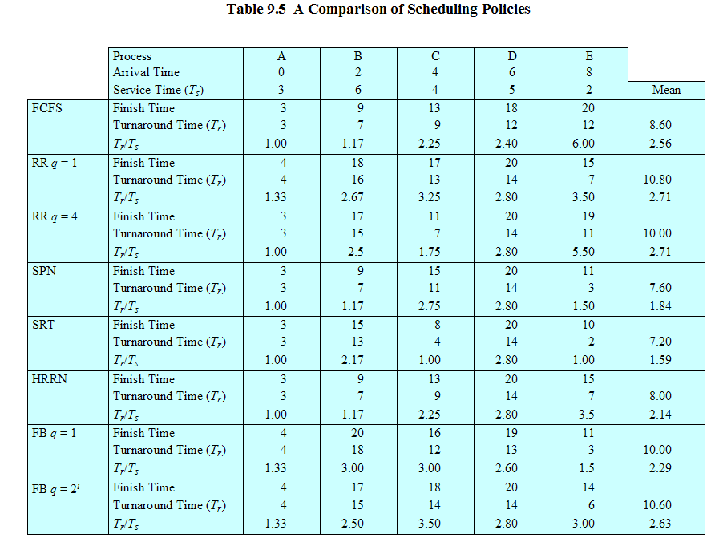

Slide 35
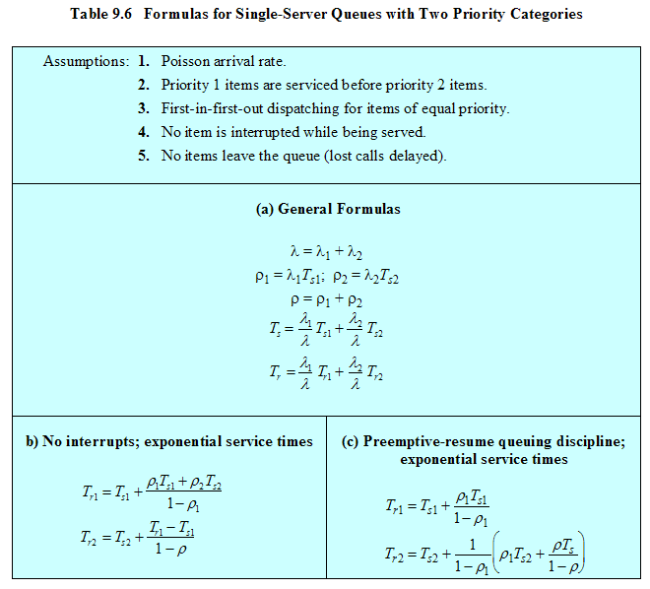

Slide 36
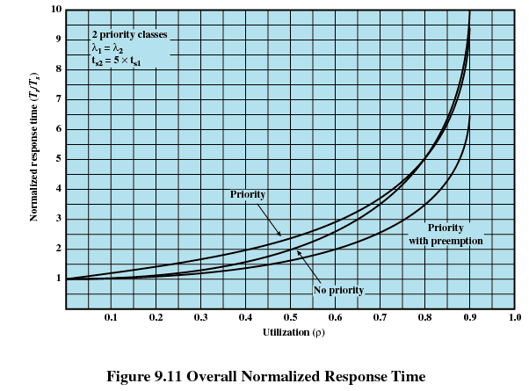

Slide 37
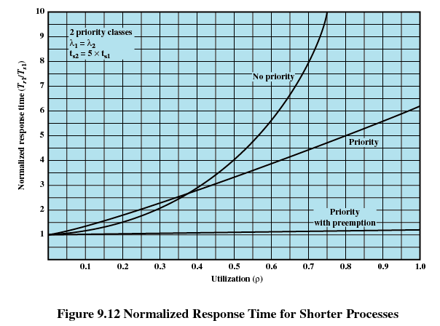

Slide 38
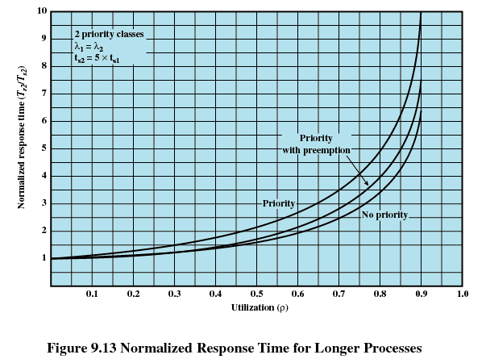

Slide 39
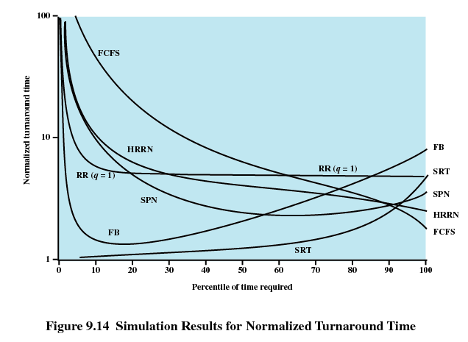

Slide 40
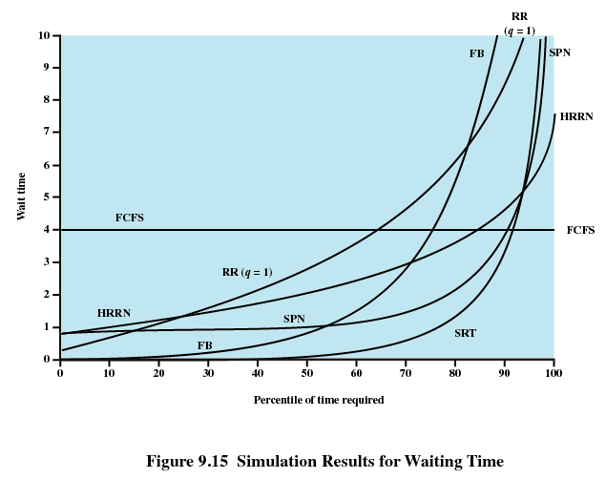

Slide 41
Fair-Share Scheduling
User’s application runs as a collection of processes (threads)
User is concerned about the performance of the application
Need to make scheduling decisions based on process sets

Slide 42
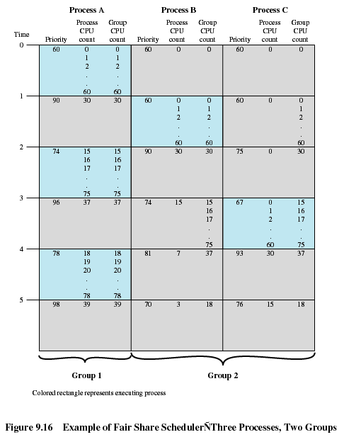

Slide 43
Ejercicio
Cinco trabajos por lotes (A al E). Llegan al centro de procesamiento al mismo tiempo. Tienen tiempos estimados de ejecución 15,9,3,6 12. Tiene prioridades con 6,3, 7, 9, 4.
Para cu de los siguientes algoritmos de planificación:
  Tiempo de estancia de cada proceso y el promedio

Slide 44
Ejercicio
  Ignore el cambio de tiempo de contexto.
En los últimos 3 casos asuma que no es apropiativo y que son puramente demandantes de CPU.
  Planificación de turno rotatorio con rodaja de 1 minuto.
  Planificación por prioridades
  FCFS (15,9,3,6,12)
  El proceso más corto primero

Slide 45
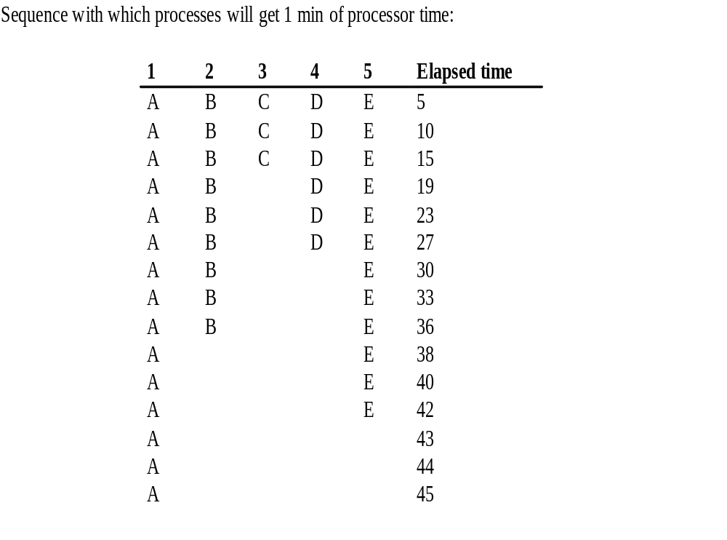
Turno rotatorio

Slide 46
Turno rotatorio
A = 45 min, B = 35 min, C = 13 min, D = 26 min, E = 42 min
El promedio es = (45+35+13+26+42) / 5 = 32.2 min

Slide 47
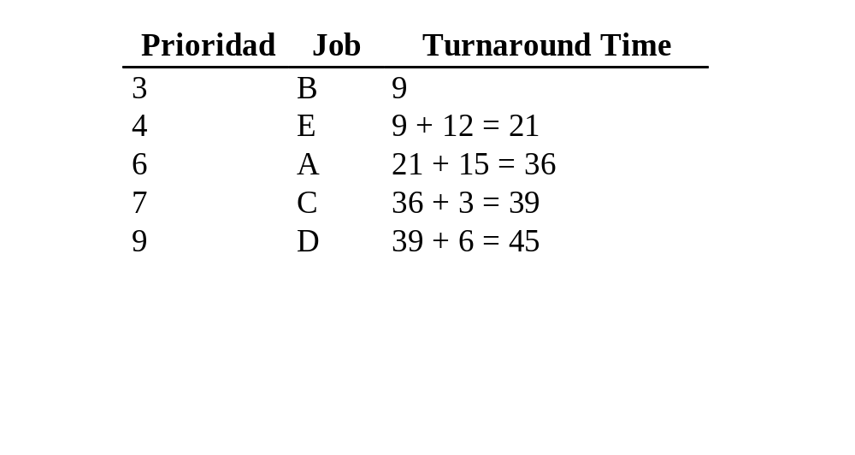
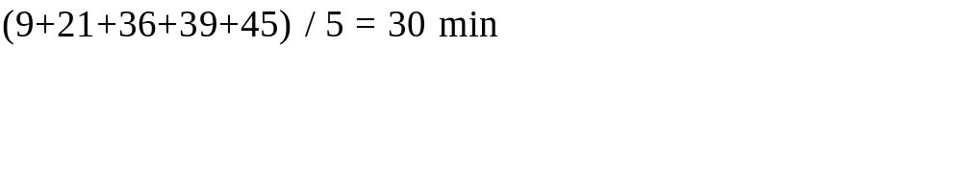
Por prioridades

Slide 48
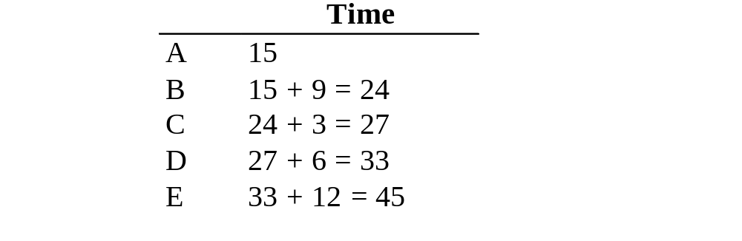

FCFS

Slide 49
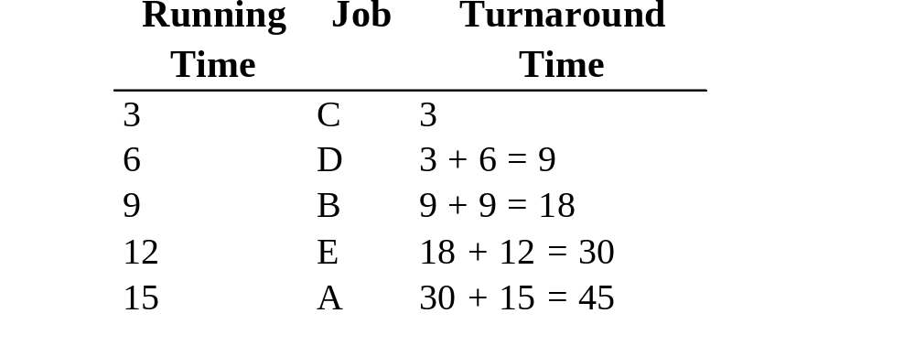

Proceso más corto

